Slide 1



Azure Bicep:
The Future of Infrastructure as Code!
Everyone can code!
Learn how to deploy Azure resources with Bicep
Hosted By:
Karthik Kannan

Slide 2


What is Bicep?
Bicep
Azure Bicep is a domain-specific language (DSL) that simplifies the deployment of Azure resources by providing an easier alternative to JSON-based ARM templates. Bicep helps you define infrastructure as code (IaC) in a declarative format and deploy resources in a more readable and maintainable way.
Everyone can code!

Slide 3
What is Bicep?
Bicep
A declarative language for deploying Azure resources
Simplifies ARM templates
More readable and modular than JSON
Everyone can code!

Slide 4
Why Use Bicep?
Bicep
Key Benefits:
Easier to read & write
No need for complex JSON syntax
Reusable modules for better management
Supports all Azure resources
Everyone can code!

Slide 5
Prerequisites for Bicep
Bicep
Install Azure CLI
Install VS Code
Install Bicep Extension
Install Bicep Module via PowerShell
Everyone can code!

Slide 6
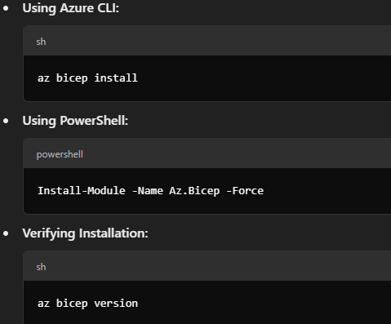
Installing Bicep
Bicep
Install VS Code IDE : https://code.visualstudio.com/download
Everyone can code!

Slide 7
Installing Bicep
Bicep
Azure CLI Commands
log in to your Azure account: az login
Check accounts: az account list --output table
To select a subscription
az account set --subscription "SUBSCRIPTION_ID"
az account show --output table
Check resource groups: az group list --output table
Create RG az group create --name bicepDemoRG --location eastus
Everyone can code!

Slide 8
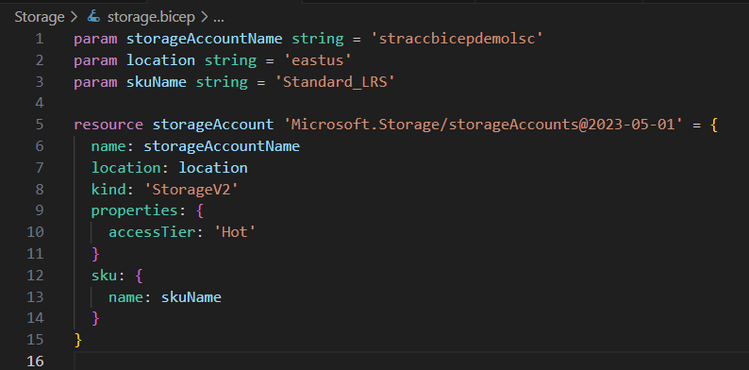
Writing Your First Bicep Template
Bicep
Everyone can code!

Slide 9
Bicep: Deploying the Storage Account
Bicep
Azure CLI Commands
To deploy a Bicep use command
az deployment group create --resource-group bicepDemoRG --template-file storage\storage.bicep
Everyone can code!

Slide 10
Converting JSON to Bicep (Decompilation)
Bicep
Why Decompile?
Easily migrate old ARM templates to Bicep
Make templates more readable and manageable
Azure CLI Commands
To Decompile a JSON ARM template to a Bicep use the command
az bicep decompile --file "C:\Work\repos\karthik\SmartCertify\Bicep\JsonTemplates\webapp.json"
Everyone can code!

Slide 11




HANDS ON PRACTICE
VISIT HTTPS://GITHUB.COM/
LEARNSMARTCODING
BY KARTHIK KANNAN
https://www.youtube.com/@learnsmartcoding

Slide 12



THANKS FOR
WATCHING
BY KARTHIK KANNAN
https://www.youtube.com/@learnsmartcoding

